Slide 1


micro:bit programming tutorial
micro:bit
Preparation before class
Yahboom micro:bit tutorial

Slide 2
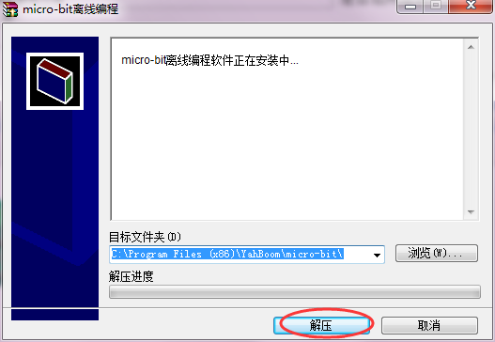
micro:bit programming tutorial
installation steps：
1.You need to open setup package to find
Yahboom micro-bit Graphical programming V1.0.exe
2.You need to double click to open the installation
package micro-bit V1.0.exe and decompress it.
Yahboom micro:bit tutorial

Slide 3
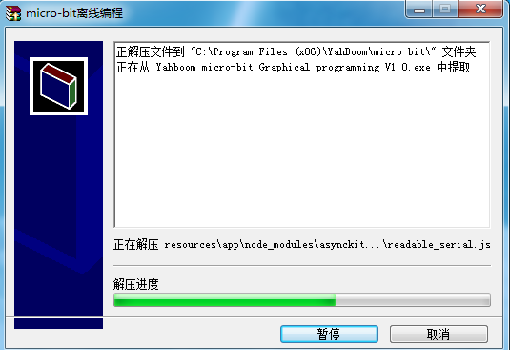
micro:bit programming tutorial
3.The decompression process is shown in the following picture.

Slide 4
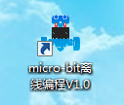
micro:bit programming tutorial
4.You need to wait for the progress bar to complete. When the shortcut to the software appears on the desktop, it means that you have successfully installed the software. As shown in the following figure.
Use instructions of Micro:bit offline programming software is shown in the following picture: 1. You can double-click to use it. As shown in the following figure.
Yahboom micro:bit tutorial

Slide 5
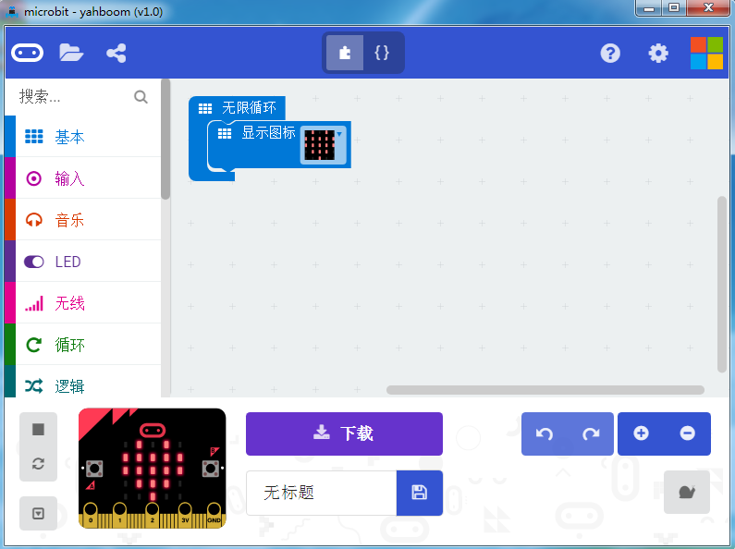
micro:bit programming tutorial
2.You can switch the language by clicking the icon in the upper right corner, as shown on the right.
Yahboom micro:bit tutorial

Slide 6
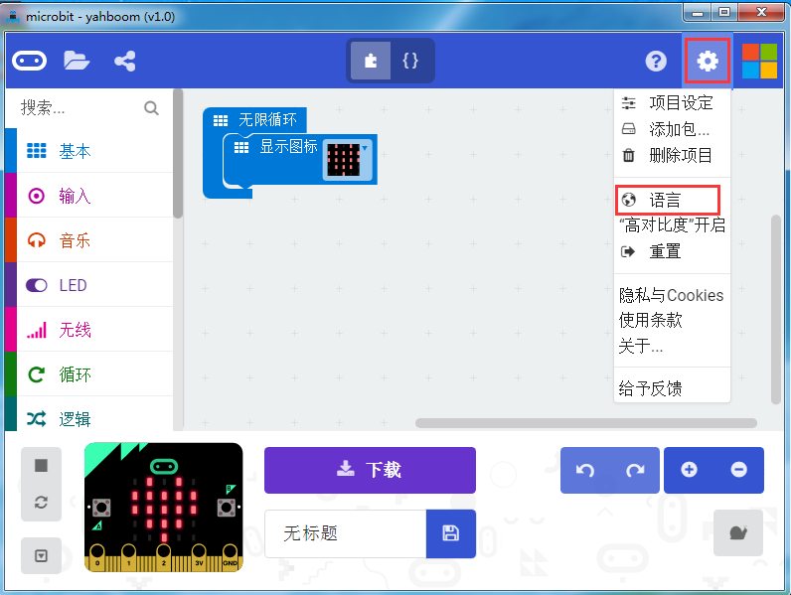
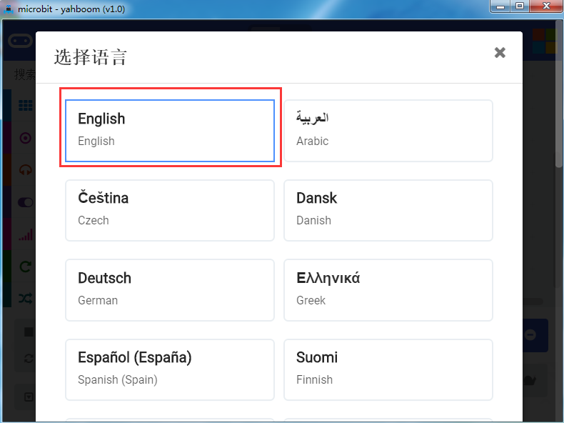
micro:bit programming tutorial
Yahboom micro:bit tutorial

Slide 7
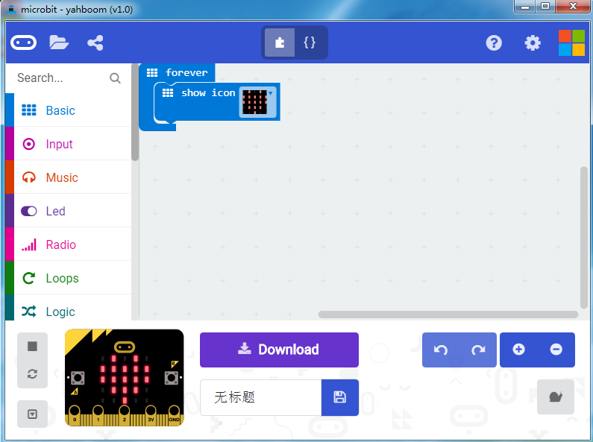
micro:bit programming tutorial
3.After you completed, you can see the English interface. As shown on the right.
Yahboom micro:bit tutorial

Slide 8
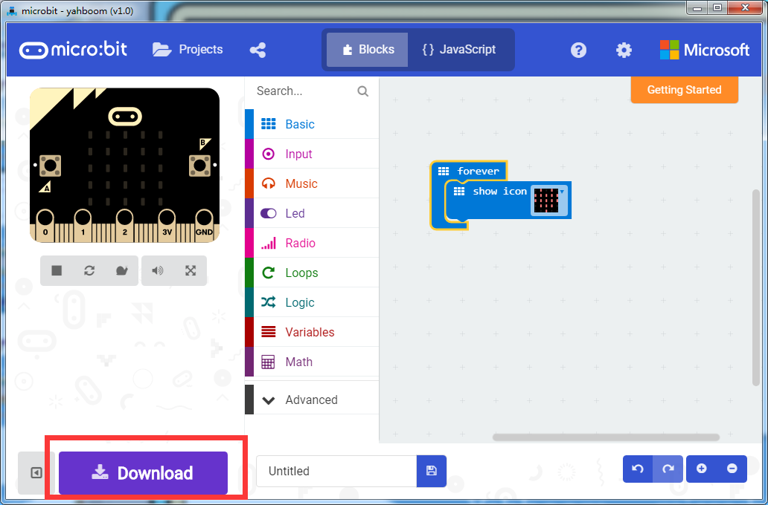
micro:bit programming tutorial
Download the program:
After the building blocks, you use the USB cable to connect the micro:bit to the computer. Click on the download as shown on the right, the program will be downloaded to the micro:bit.
Yahboom micro:bit tutorial

Slide 9
micro:bit programming tutorial
micro:bit
Thanks for watching！
Yahboom
Yahboom micro:bit tutorial

